Slide 1

Predicting the daily orders
By Yordanos W
2021

Slide 2
Content
1. Business need & goal
3. EDA
4. Future work

Slide 3
Business Need
10,000 In-store shoppers
½ million Full-service shoppers
Problem : In-store shopper layoffs

Slide 4
Proposal
Predict daily and hourly orders
Find required number of shoppers
Use the estimates for revenue generation
Balance between shoppers & allocation

Slide 5
Impact Hypothesis
Find out how many instore shoppers are needed and switch them between shops according to demand to minimize layoffs.

Slide 6
Data & tools
The Instacart Online Grocery Shopping Dataset 2017
Dataset : the last 100,000 rows
Data analysis & Cleaning: Excel
Data visualization : Tableau

Slide 7
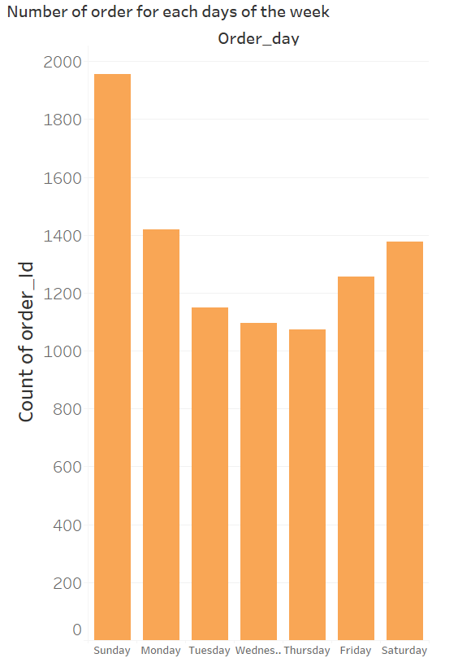
Similar number of demands throughout the week

Slide 8
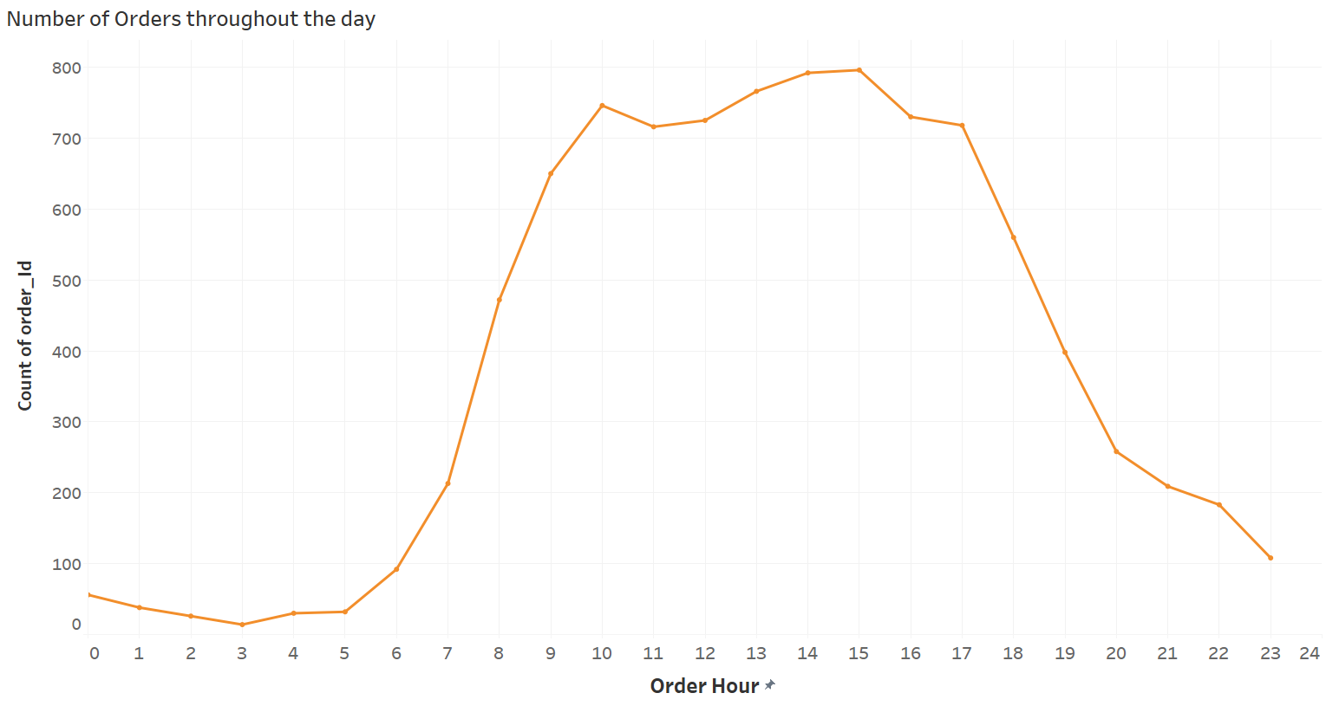
High number of orders 8 AM – 6 PM

Slide 9
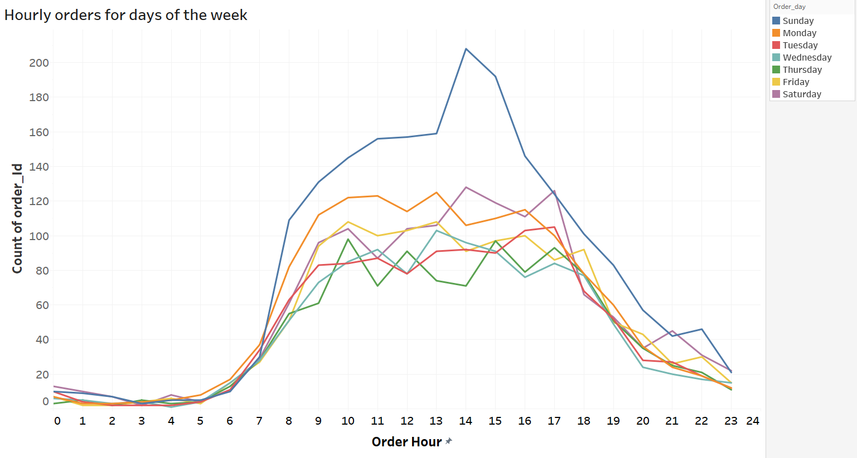
Similar patterns between days of the week

Slide 10
Future work
-EDA with additional data: Zip code, Stores
-Time series predictive model: ARIMA

Slide 11
Thank you!

Slide 12
Appendix
Summery Statistics for number of orders
Mean | 10.56824274
Standard Error | 0.082591515
Median | 9
Mode | 5
Standard Deviation | 7.976390703
Sample Variance | 63.62280865
Kurtosis | 3.14202872
Skewness | 1.466314701
Range | 69
Minimum | 1
Maximum | 70
Sum | 98570
Count | 9327

Slide 13
